Slide 1
LUCIANIC
MEDITATION
LUCIAN GREEN
DOUBLE DIPLOMA, OCTOBER 2012

Slide 2
INTRODUCTION
This will give you a taste of Lucianic Meditation.
I began practising Transcendental Meditation, which Lucianic Meditation is based on, in 2000. I took away a love of life from it.
OHS: When writing a lot, be careful to avoid repetitive strain injury, neck and headache.
Ice breaker: Does anyone currently write essays or practise meditation?
Objective: To teach you the fundamentals of LM.
Benefit: Hopefully your quality of life will increase with LM.

Slide 3
Religious way of fulfilling education and religious competencies
This course is religious, meaning that it should accepted on the grounds that it achieves the goal of meditation (supports the work of a monk) and the goal of pedagogy (contains concrete ways of recognizably earning A grade in an essay, where pedagogy covers both pedagogy, the study of teaching of students as well as andragogy, the study of teaching adults) on the grounds of using algorithms, some of which are based on praying (hoping God will be there).

Slide 4
Uses for this course’s A grade essay writing skill
The goal of the pedagogy component of this course is to produce arguments such as the Anarchy Quiz, which are high quality enough to earn A grade and allow approval by managers, etc., for earning jobs, and convince potential buyers that the product is high quality so that they buy it, and allow babies to born because the parents have proven the child is protected by being blessed with A.

Slide 5
Example argument
The following is the Anarchy Quiz, which has the seen-as version of protecting people until there is government with army-law: (You will be able to produce material like this by the end of this course.)

Slide 6
Anarchy Quiz, p. 1
Anarchy Quiz
Earn A in 85 questions. Use the A you earn to earn A in an assignment, earn a job or earn an acting role.
You still have to do the work, and there are no guarantees.
For these questions, do not check any previous answers before answering, and do not submit the same set of answers twice or more for different purposes.

Slide 7
Anarchy Quiz, p. 2
Ideally, you should follow the tutorial, which contains the pre-requisite knowledge needed to "earn A" to do anything you want, within reason! This may be found at http://lucianspedagogy.blogspot.com/p/welcome.html .
1. What is the reason you would like to complete this quiz?
This seen-as essay will be breasoned out by you (you will be asked for the x, y and z dimensions of each object from a short sentence about the army, originally the argument for my essay on anarchy, which I wrote a pop-song about (http://luciangreen.blogspot.com).

Slide 8
Anarchy Quiz, p. 3
EXPOSITION:
What are the x, y and z dimensions in metres of "cup" in "The soldier cleaned himself with a cup of water"?
What are the x, y and z dimensions in metres of "bottle" in "The soldier drank a bottle of apple juice"?
What are the x, y and z dimensions in metres of "apple" in "The soldier put an apple in his lunch-box"?
What are the x, y and z dimensions in metres of "periscope" in "The soldier looked at the stand through the periscope"?
What are the x, y and z dimensions in metres of "pear" in "The soldier ate a pear with the friend he found on the Internet"?
CRITIQUE:
What are the x, y and z dimensions in metres of "brick" in "The soldier stood on a brick, which was like a wall"?
What are the x, y and z dimensions in metres of "log" in "The soldier stepped over the log"?
What are the x, y and z dimensions in metres of "flag" in "The soldier found a flag"?
What are the x, y and z dimensions in metres of "bun" in "The soldier ate a bun, which he had bartered for"?

Slide 9
Anarchy Quiz, p. 4
DETAILED REASONING:
What are the x, y and z dimensions in metres of "tofu" in "The soldier ate tofu"?
What are the x, y and z dimensions in metres of "garbage bag" in "The soldier moved the garbage bag"?
What are the x, y and z dimensions in metres of "nuts" in "The soldier chewed nuts at the theatre"?
What are the x, y and z dimensions in metres of "processed cheese" in "The soldier bit processed cheese"?
What are the x, y and z dimensions in metres of "cup" in "The soldier swallowed a cup of grape juice"?
What are the x, y and z dimensions in metres of "roll" in "The soldier ate a roll with vegan cheese"?
What are the x, y and z dimensions in metres of "peanut" in "The soldier nipped a peanut"?
What are the x, y and z dimensions in metres of "nectarine" in "The soldier munched a nectarine"?
What are the x, y and z dimensions in metres of "sugar" in "The soldier packed sugar in his bag"?
What are the x, y and z dimensions in metres of "ball" in "The soldier threw a ball in the air"?

Slide 10
Anarchy Quiz, p. 5
22. What are the x, y and z dimensions in metres of "banana" in "The soldier peeled the banana"?
23. What are the x, y and z dimensions in metres of "orange" in "The soldier squeezed the orange"?
24. What are the x, y and z dimensions in metres of "mandarin" in "The soldier removed a segment from a mandarin"?
25. What are the x, y and z dimensions in metres of "bra" in "The soldier made a bra"?
26. What are the x, y and z dimensions in metres of "stand" in "The soldier jumped to touch the top of the stand"?
27. What are the x, y and z dimensions in metres of "ring" in "The soldier wore a ring"?
28. What are the x, y and z dimensions in metres of "watering container" in "The soldier watered the apricot tree with the watering container"?
29. What are the x, y and z dimensions in metres of "base" in "The soldier placed the base on the flat ground"?
30. What are the x, y and z dimensions in metres of "abdominal muscle exerciser" in "The soldier exercised his abdominal muscles with the abdominal muscle exerciser"?
31. What are the x, y and z dimensions in metres of "flask" in "The soldier gargled water from his flask”?
32. What are the x, y and z dimensions in metres of "dried fig" in "The soldier chewed the dried fig"?
33. What are the x, y and z dimensions in metres of "shorts" in "The soldier ran on the spot in shorts"?

Slide 11
… skip …

Slide 12
Anarchy Quiz, p. 15
:
78. What are the x, y and z dimensions in metres of "friend" in the sentence "The soldier found the friend of his who mentioned the same key phrase as him"?
79. What are the x, y and z dimensions in metres of "three friends" in the sentence "The soldier found two other friends, each of whom said the same key phrase as another one in the group"?
80. What are the x, y and z dimensions in metres of "objects" in the sentence "The soldier found objects representing what he and his three friends had said they needed together"?
81. What are the x, y and z dimensions in metres of "the library" in the sentence "The soldier checked the random place: the library"?
82. What are the x, y and z dimensions in metres of "the conference room" in the sentence "The soldier checked the conference room, in the library"?
83. What are the x, y and z dimensions in metres of "the encyclopaedia" in the sentence "The soldier read an article in the encyclopaedia to read widely"?
84. What are the x, y and z dimensions in metres of "the blank book" in the sentence "The soldier wrote his own encyclopaedia article in the blank book"?
85. What are the x, y and z dimensions in metres of "wheat biscuits" in the sentence "The soldier moistened wheat biscuits after he answered a girl friend's call"?
86. What are the x, y and z dimensions in metres of "glove" in the sentence "The soldier inserted his hand in his glove"?

Slide 13
Training for Schools and Universities
This course is the high quality version of the course like it, and shows detailed examination of all areas that are necessary to achieve its goals. Not only will the pedagogy component work in any current school or university, but assessment tools with its criteria made explicit as their own will also work in proposed Lucianic schools.

Slide 14
Pedagogical Principles
Lucianity is the Lucianic Meditation technique (LM). Each time the Lucianic mantra is said, A grade essays are remembered. A also deserves successful conception, employment, blessing or A in a school or University assignment. These essays deserve A because they contain impactful sentences, which is what this talk will train you to do.

Slide 15
Ideas
The following ideas should be represented in high quality work.
1. Two uses
Include two uses or ideas about an idea from your essay. For example, an apple is used to eat and contain seeds. Eating is useful because it helps keep us alive and seeds are useful because they help the species continue on to the next generation.

Slide 16
Ideas
2. Future
Think about how one of your ideas relates to the future. For example, students should learn to read so they can drive in later life.

Slide 17
Ideas
3. Two types
Think about how two objects are co-ordinated in relation to each other. For example, milk softens weet-bix, making it easier to digest.

Slide 18
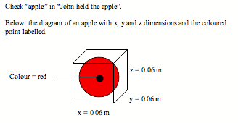
Breasoning
Think of the measurements in the x, y and z dimensions of each object (their "breasonings"). Breasonings help
e.g. apple’s breasonings are 0.06, 0.06 and 0.06 m

Slide 19
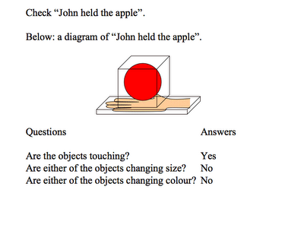
Rebreasoning
Think of the fact that the verb in a sentence describes the fact that the subject touches the object in a sentence.
E.g. John touched the apple.

Slide 20
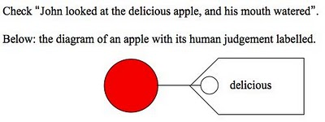
Breathsoning
Think of an adjective (a "breathsoning"), which is a human judgement for each noun, i.e. the subject and object in a sentence
e.g. The apple is delicious.

Slide 21
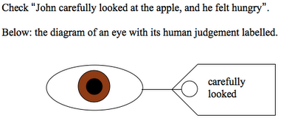
Rebreathsoning
Think of an adverb (called a "rebreathsoning"), which is a human judgement for each verb.
e.g. John carefully look at the apple.

Slide 22
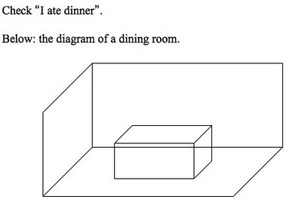
Space Tests - Room
a. Which room is the proposition set in?
e.g. “I ate dinner in the dining room”.

Slide 23
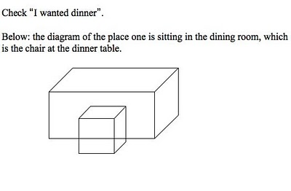
Part of Room
b. Which part of the room is it set in?
e.g. “I ate dinner sitting in the first seat at the table”.

Slide 24
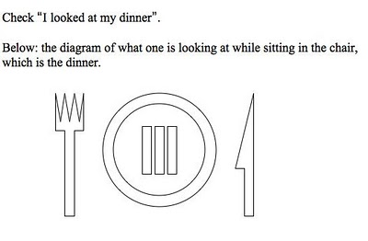
Direction
c. Which direction is the person facing?
e.g. “I looked at my dinner facing east”.

Slide 25
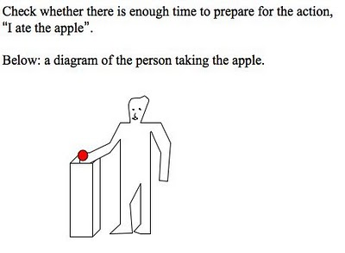
Time Tests – Time to Prepare
Time Tests
a. Test that there is enough time to prepare for the action.
e.g. John lifted up the apple.

Slide 26
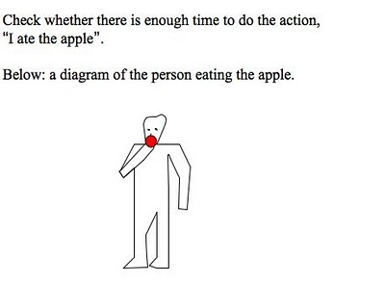
Time to Do
b. Test that there is enough time to do the action.
e.g. “John ate the apple”.

Slide 27
Time To Finish
c. Test that there is enough time to complete the action,
e.g. John threw away the apple core.

Slide 28
How many breasonings do I need for 80%?
Exposition: 5 br
Critique: 5 br
Detailed Reasoning: 25 br
Mind Map: 50 br
Total: 85 br

Slide 29
How many breasonings do I need for 90%?
Idea others in this group are connected with: 1 br
9 ideas connected to first idea: 9 br
2 breathsoning-related (human judgment of object) ideas connected to 2 of the 9 ideas: 2 br
1 rebreathsoning-related (human judgment of verb) ideas connected to 1 of the 9 ideas: 1 br
This group x 10 = 19 x 10 = Total 130 br

Slide 30
How many breasonings do I need for 100%?
Idea others in this group are connected with: 1 br
9 ideas connected to first idea: 9 br
2 breathsoning-related (human judgment of object) ideas connected to 2 of the 9 ideas: 2 br
1 rebreathsoning-related (human judgment of verb) ideas connected to 1 of the 9 ideas: 1 br
6 space and time test related ideas connected to 6 of the 9 ideas: 6 br
This group x 10 = 19 x 10 = Total 190 br

Slide 31
God Algorithm
To breason out an A, that can be an 80%, 90% or 100% for 85, 130 or 190 breasonings respectively:
1. Spiritually "turn off" the following, meaning it is protected.
2. Spiritually "play" 3 previously breasoned out As (done using Lucian Green's Anarchy Quiz to God (meaning that it is protected). This means one hopes God will be there.
3. Breason out the object by thinking of it's x, y and z dimensions.
4. Spiritually place a Lucian doll on the left side of a stage with you behind it, looking at the object.
Next page….

Slide 32
God Algorithm
5. Move Lucian to the right, to a mother doll, to forget the object.
6. Imagine the object is replaced with a counter. Move Lucian to the left, to recognise that it is divine, and spiritually listen to him saying a three line prayer, "I love you", "I love you dearly" and "I love you forever".
7. To help the counter and it's seen as version to move forward in a straight line, say "It is a line", then say "It (the imagery I thought of) is the same (recognised to be Godly by me)", then repeat the three prayer points, "I love you", "I love you dearly" and "I love you forever". This step "dots on" the breasoning in a "high quality way".

Slide 33
Professor Algorithm
Like the God Algorithm, provides a prayful way of blessing reasons, in particular the object in a subject “Sentence Verb Object”.
Make sure the object is visualised in a high quality way.
1. Look at a shiny blue object
2. Lift a small blue object by lifting up the shiny blue object, meaning the white object underneath is high quality.
3. Think that a blue object under the white object is not relevant (from another time the algorithm will be used), so put it away.

Slide 34
1 Question Quiz
Once one has “cleaned the model” using either of these algorithms, one can write a one-sentence essay naming the object the model was of. To amply test that one has chosen the right word for the object by visualising it, one should “breason out” the object, as follows:
e.g. the Anarchy Quiz from earlier is an essay of this kind:
What are the x, y and z dimensions in metres of "cup" in "The soldier cleaned himself with a cup of water”?

Slide 35
Meditate with a breasoning thought of quickly in a few seconds
How quickly can you think? Try to repeat the following dimensions in centimetres (not the name of the object) in five seconds on your Smart phone stop watch (under Utilities>Clock>Stop watch).
Cup 6 6 10
Bottle 5 5 25
Apple 6 6 6
Periscope 1 1 5
Pear 6 6 10

Slide 36
Mantra and Sutra
Now that one has the ability to think quickly, one can repeat the mantra and sutra. Repeat the mantra “Lucian” for twenty minutes twice per day, and the sutra “Green” for twenty minutes twice per day.

Slide 37
Conclusion
Discussion
Please complete the feedback form.
For more information: http://lucianspedagogy.blogspot.com and http://lucianicmeditation.blogspot.com

